Slide 1
Latest Algorithm Changes Audit May 4th – 4th June 2020
For Mybettingdeals.com
(Prepared by – Thatware)

Slide 2
Synopsis 1: Topics Competition
The first synopsis on what we did is on Topic competitions which showcases the level of pages within the website competing with each other.
We have found approximately 42.63% of the pages are competing with each other for an exact match term. A small highlight here https://docs.google.com/spreadsheets/d/1IeN2NdSu_qGvmXwQygvL6lxVyhoemNlfzms0XOxcm1w/edit?usp=sharing
Cannibalization is also wasting crawl budget at 5.87 times from April 2020

Slide 3
Solution for Synopsis 1
After a thorough audit we found that 60% out of 42.63% cannibalization issues appears from /video/ pages alone.
With the above point being said, all the /video/ pages should be merged into a new page using 301. PLEASE DONOT DELETE ANYTHING as merging will help in transferring valuable assets like referring domains and link juice. However, the page content can be ignored.
Keyword segmentation rule is to be de-optimized for main pages vs. video pages (discussed more on Synopsis 8).

Slide 4
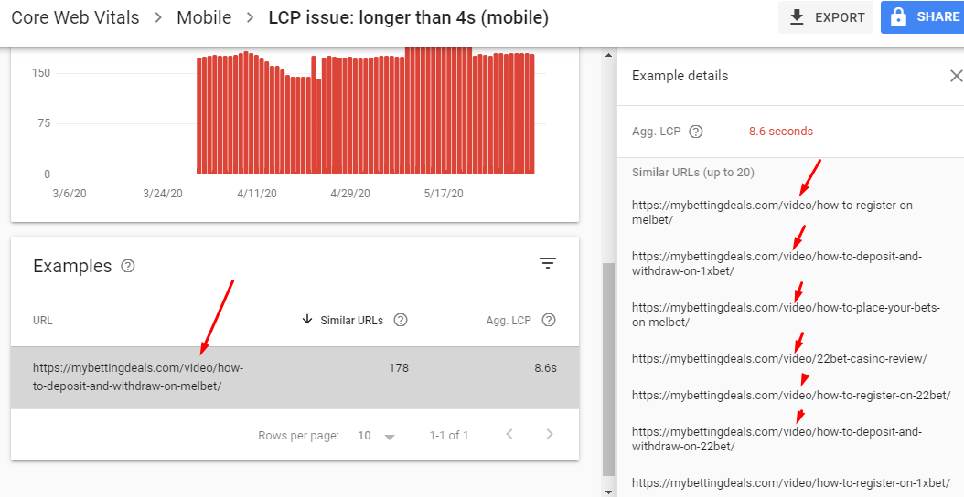
Synopsis 2: Web Vitals (LCP)
Core web vitals such as FID, visual stability and LCP can now make impact for performance on SERP.
We have found majority of the web vitals issues are from existing video pages which needs to be immediately fixed. (Solutions in next slide)

Slide 5
Solution for Synopsis 2
All the video pages should be merged into a new page as discussed on Synopsis 1.
The new structure for the video pages should be please follow the report here: https://docs.google.com/document/d/1C9PaMB94AJWuuKgekHXqEC8-cV_h1lupoOQ8UGftL6c/edit?usp=sharing
Developer should make sure the Title and first fold loads together.

Slide 6
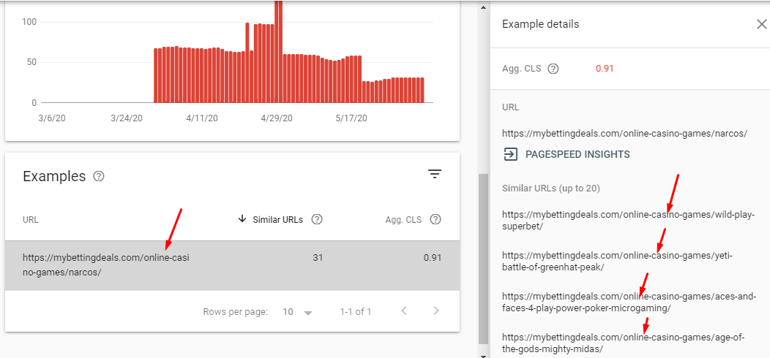
Synopsis 3: Web Vitals (Visual Stability)
Core web vitals such as FID, visual stability and LCP can now make impact for performance on SERP.
We have found majority of the web vitals issues are from existing online-casino-games pages which needs to be immediately fixed. (Solutions in next slide)

Slide 7
Solution for Synopsis 3
The first fold layout for online-casino-games pages creates a bad user experience as it loads exceeding screen size. Thereafter, the dimension needs to be changed.
Also, the first fold should start with a paragraph.

Slide 8
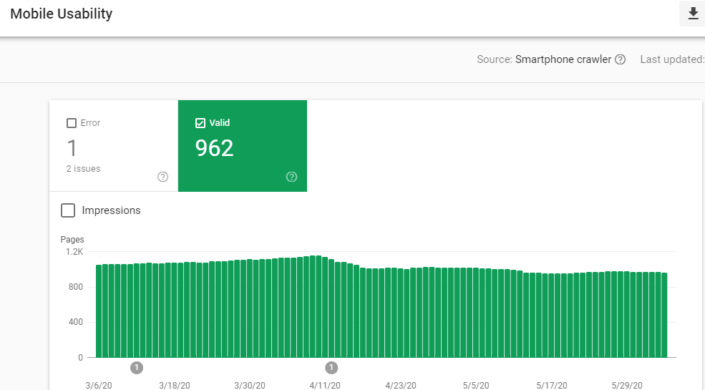
Synopsis 4: Mobile First Indexing
Mobile pages should have highest priority for indexing and in current case we see a lesser index rate on Mobile as compared to the desktop.
Low mobile indexing will make an impact as it will attract lower customers from mobile devices.

Slide 9
Solution for Synopsis 4
All the web crawlers should be individually allowed via Robots.txt https://support.google.com/webmasters/answer/1061943?hl=en
All the video pages are missing from mobile index. However, with the new video page as per Synopsis 1. We need to include the URLs on sitemap and also create 2 sitemaps video + contexts and with proper priority order these will be fully indexed.
Extensive XML modifications (Tuhin will guide) and AMP removal

Slide 10
Synopsis 5: Zombie Pages
Unwanted pages should be de-indexed and blocked from crawling. This will thus save lot of crawl budget.
With the above point on mind, this step would also help to ensure that we don’t face any index bloat issues.
Less interactive pages or OLD pages with dates should be deleted.
Paginated URL’s also falls in this category

Slide 11
Solution for Synopsis 5
All glossary, members, tags, /pages and unwanted pages should be de-indexed via meta robots and also should be blocked from crawling.
Disallow: /tags Disallow: /members Disallow: /pages Disallow: /glossary The above rule should be applied on Robots.txt

Slide 12
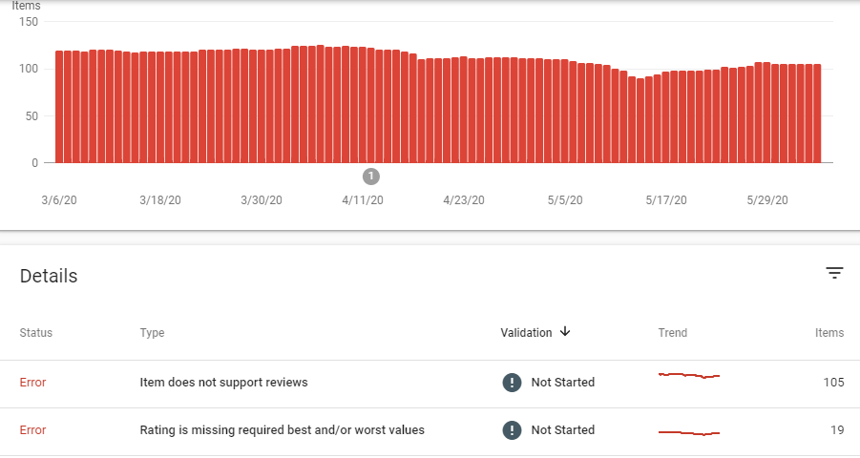
Synopsis 6: Structured data
Structured data errors have been encountered in GSC which needs to be resolved.
Video structured data needs implemented.
QnA structured data needs implemented.
Query structured data needs implemented.

Slide 13
Solution for Synopsis 6
Errors in existing structured data as reported through GSC should be fixed.
New video page structured data should be implemented
QnA Structured data should be implemented
Page content RDFa should be implemented
Ratings and reviews should be triggered

Slide 14
Synopsis 7: Internal links structure
The current internal links structure is wasting a lot of juice on unselective pages and YMYL value is not being justified with proper usage of SILO in-linking model.
Same page URLs should be removed as it not causing any benefit
Internal links with glossary pages should be no-follow
External links should be no-follow
In-linking is missing (Reverse SILO)

Slide 15
Solution for Synopsis 7
All the YMYL pages should be in-links from video repositories and other pages.
In the above case, all the incoming anchors can be broad match or long tail. Don’t use exact match for now!
TF-IDF and BOW terms can be anchored to homepage from the YMYL pages
As seen from Screaming frog, the YMYL pages should have high incoming links than outgoing links and the ration should be 3:1

Slide 16
Synopsis 8: Keyword Segmentation Rule
Currently, keyword segmentation rule is not followed for the entire campaign. As per ideal SEO logic: 40% Exact match (currently we have 32% ) 30% long tail (currently we have < than 3 % ) 10% broad match (currently we have < 2 % ) 10% phrase match (second tier LSI) (currently we have 0%) 10% LSI keywords (currently we have < 3% ) should be followed all across the website.

Slide 17
Solution for Synopsis 8
The main branded pages should be targeted with Exact match and LSI keywords.
The new video pages should be targeted with Long tail and remaining's.
This would then help in also naturally fixing up the cannibalization issues and also attract more organic exposure for the campaign.

Slide 18
Synopsis 9: Content Structure & Solution
The current content structure looks fine. Just some tunings and should be all okay.
However, all the pages QnA sections are missing and it’s advisable to put at least 3 – 4 at minimum as QnA.
LSI’s should be used only on H3’s
Exact matches should be more “left” on H1’s.

Slide 19
Synopsis 10: Technical SEO Analysis and Solution
GSC Based
Non-GSC Based
404 handling
5XX handling
3XX handling
Query parameters handling
Re-direct chain fixes
Crawl trap fixes
De-index of Zombie pages
H-tags modifications

Slide 20
Synopsis 11: Canonicalization
Audit
Solution
All the URL’s are not self-canonicalized
All the URL’s should load without “/” and the page source should be applied a canonical with a “/”

Slide 21
Synopsis 12: E.A.T
Audit
Solution
Page contents and blogs are missing authorship information and entity matching.
Author microdata missing
Entity and authorship can be justified if we link all the contents with an external high Value assets in the name of the management (CEO, VP etc.)
Also, author entity optimisation and microdata needs to be deployed.

Slide 22
Synopsis 13: CTA optimisation
Audit
Solution
All the CTA buttons from homepage are closely placed to each other. This will lower the quality rated guidelines as per the latest updates.
The CTA’s should be spaced from each other and no CTA should be appearing on the first fold of the website.

Slide 23
Synopsis 14: BONUS TIP for MBD
All the sports betting and casino brand pages should be dynamically triggered for review microdata using GTM. This can then be linked with MREID or a AI based entity schema which can add further boost to the process. Further steps has been shown to Tuhin

Slide 24
Expected Outcome
If the recommendations are followed then there can be an expected rise of 75% of the decline
Also, additional organic exposure will be favored at least by another 28%
Clicks and impressions are likely to rise at a rate of 17% per bi-week

Slide 25
Thank you!

